Slide 1
WSC Quant
Investment strategy- Momentum

Slide 2
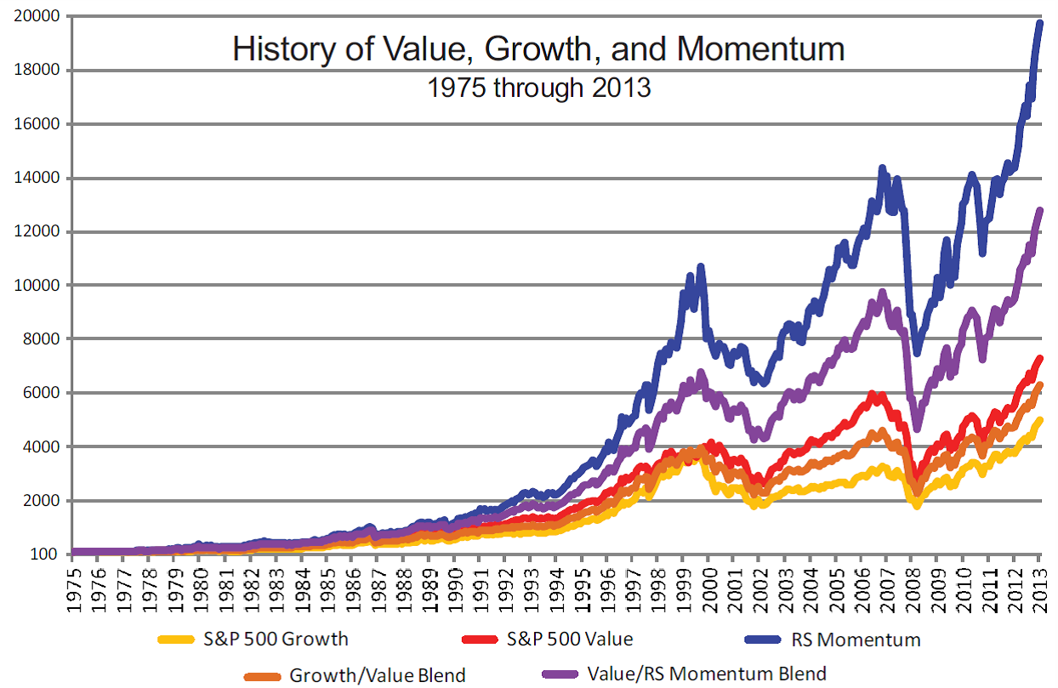
Why Momentum?
Momentum investing is a strategy that aims to capitalize on the continuance of existing trends in the market.

Slide 3
Intuition behind the strategy:
Why buy something that’s already high?
Momentum investing will sound like a nightmare for value investors.
The main idea behind momentum is that stocks that aren't rising or falling for no reason. There are participants in the market who know better.

Slide 4
Downsides:
Bleeding:
As we buy stocks that are already at their highs, during crashes or gloomy markets these are the ones that are hit the worst.
Maintaining portfolio allocation:
If your basket of stocks has 10+ stocks it might be difficult to maintain portfolio allocation.
Volatility:
Momentum portfolios often tend to show huge levels of volatility.

Slide 5
What are we going to do?
Implementing this logic in python.
Find various metrics to analyse the performance of the strategy.
Add sectoral momentum to the vanilla strategy.

